Slide 1
MERCEDES USED CAR DATASET
PREPARED BY : K.S.ABISHEK 4TH OF MARCH, 2023

Slide 2
BRIEFING
The dataset was obtained from Kaggle on the 3rd of March , 2023.
Business objectives and insight aims were not provided. The following questions were aimed at being answered by gaining insights. These include:
Model vs Price trends
Transmission type vs Price trends
Fuel efficiency vs Transmission type
Engine size vs Price trends
Model vs Tax trends
Most and least driven models

Slide 3
Data cleaning
The dataset was checked for duplicate values. The count of duplicate values stood at 239. The duplicate values were extracted using Python and written to a separate excel sheet [‘duplicate values.xlsx’].
The original dataset was further cleaned using excel by removing duplicates for further analysis.

Slide 4
ANSWERING QUESTIONS THROUGH BI TOOLS I. MODEL VS PRICE TRENDS
The following figure was developed through PowerBI to gain insights on the Model-Price trends and Model-Tax trends. The figure has been attested in the forthcoming slide to illustrate the trends.
POINTS OF OBSERVATION :
The mean tax for all models stands at 129.84 EUR.
G-CLASS cars have been sold for the highest mean value, while CLK has been sold for the least mean value.
230 series has the highest mean taxed of 520 EUR
180 series has the lowest mean tax at 20 EUR

Slide 5
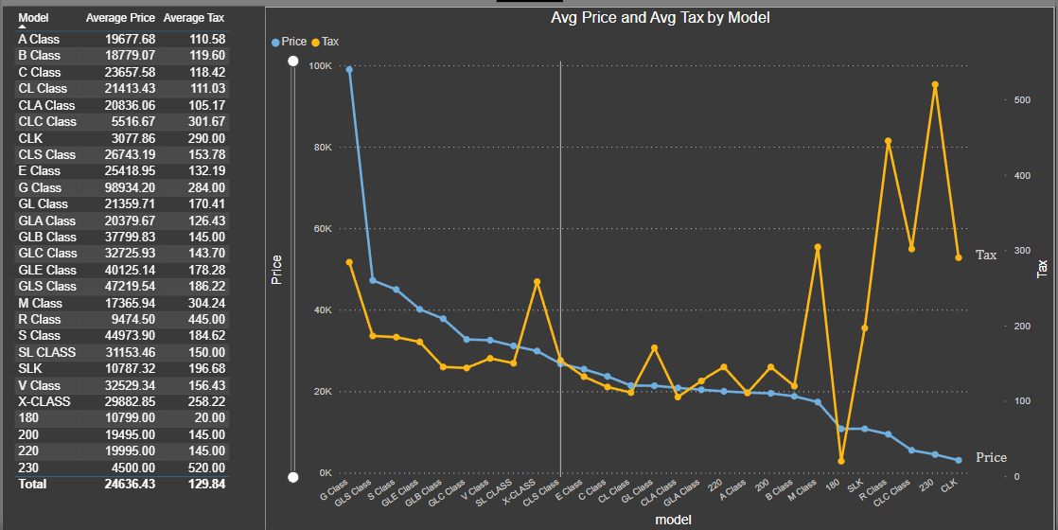

Slide 6
Transmission & fuel type vs price trends
The following figure attested in the forthcoming slides illustrates the aforementioned trends.
Points of observation :
Petrol variants have the highest mean price in the used car market at 28240 EUR , with petrol semi-automatic being the priciest and manual being the lowest.
Diesel types follow the same trends , the mean price at 23216 EUR
Hybrid cars only have two versions – Automatic and semi-automatic, Semi-automatic being the costliest (25319 EUR). Hybrid cars have and average price of 22.8K EUR

Slide 7
